Slide 4
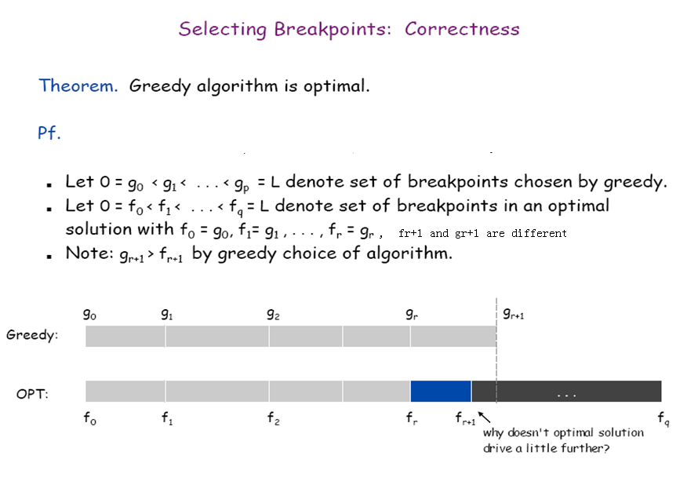

Slide 5
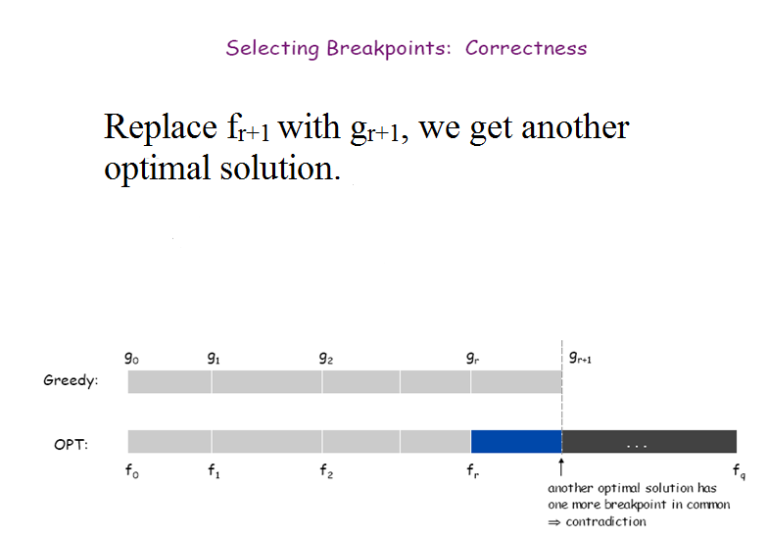
Repeating the process, we can show that greedy solution is the same as an optimal solution .

